Slide 1
Module 7: Regional Scale Test Pits
Dylan Craaybeek

Slide 2
Objectives:
Further understanding of Spatial Scale variability
Rapid data collection from a large sample size rather than sample detail, so test pits over a wide area to efficiently get any pertinent information about the snowpack instability over what could be your potential forecast zone.

Slide 3
Basic Site info:
Site | Aspect | Slope | Elevation | HS | Notes
1 | N | 3 | 8900 | 148 | BTL, open meadow up Spraddle Creek
2 | NW | 23 | 7950 | 122 | BTL, small steeper slope on Grouse mountain
3 | SE | 10 | 1600 | 290cm | NTL, meadow sheltered by trees on mountain top

Slide 4
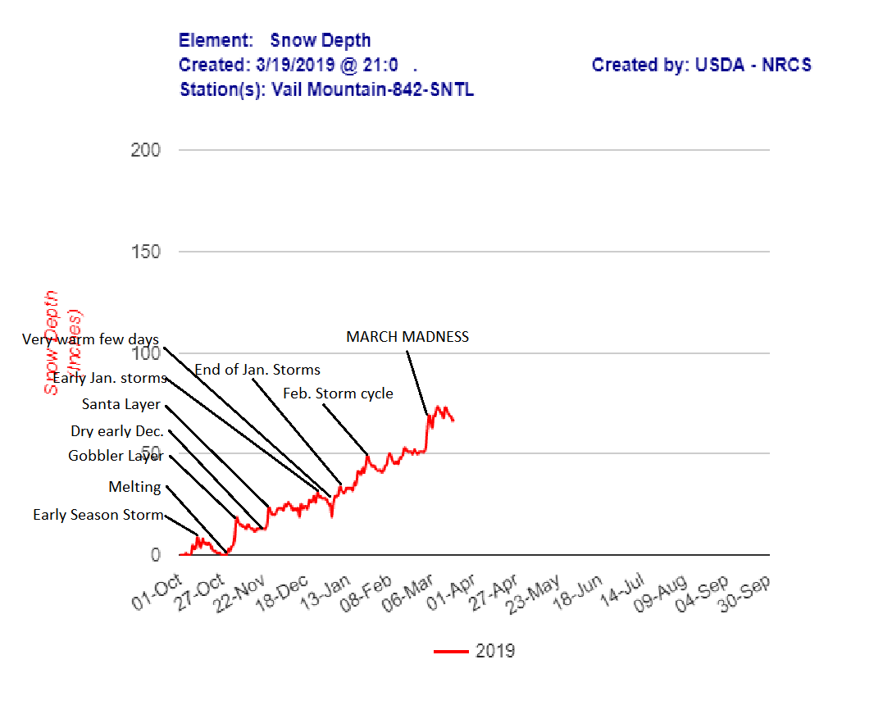
Significant Seasonal Weather Events

Slide 5
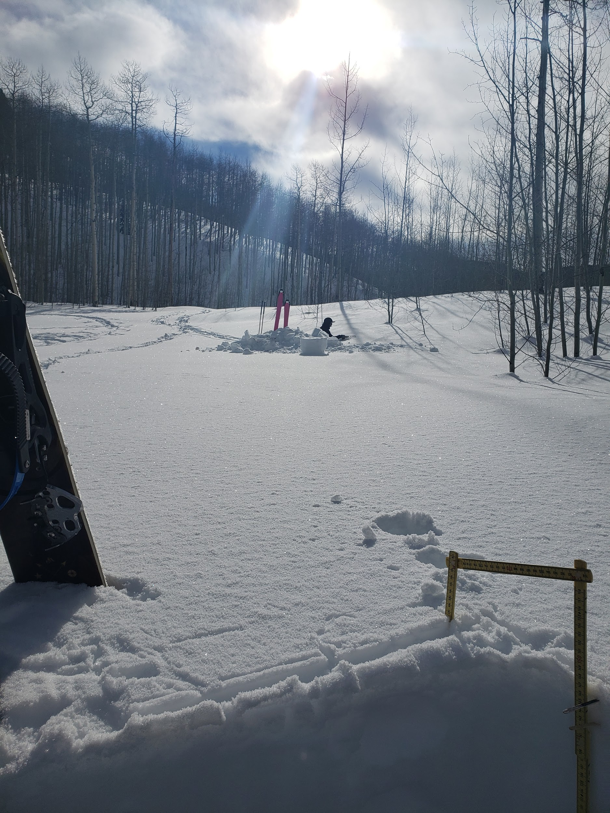
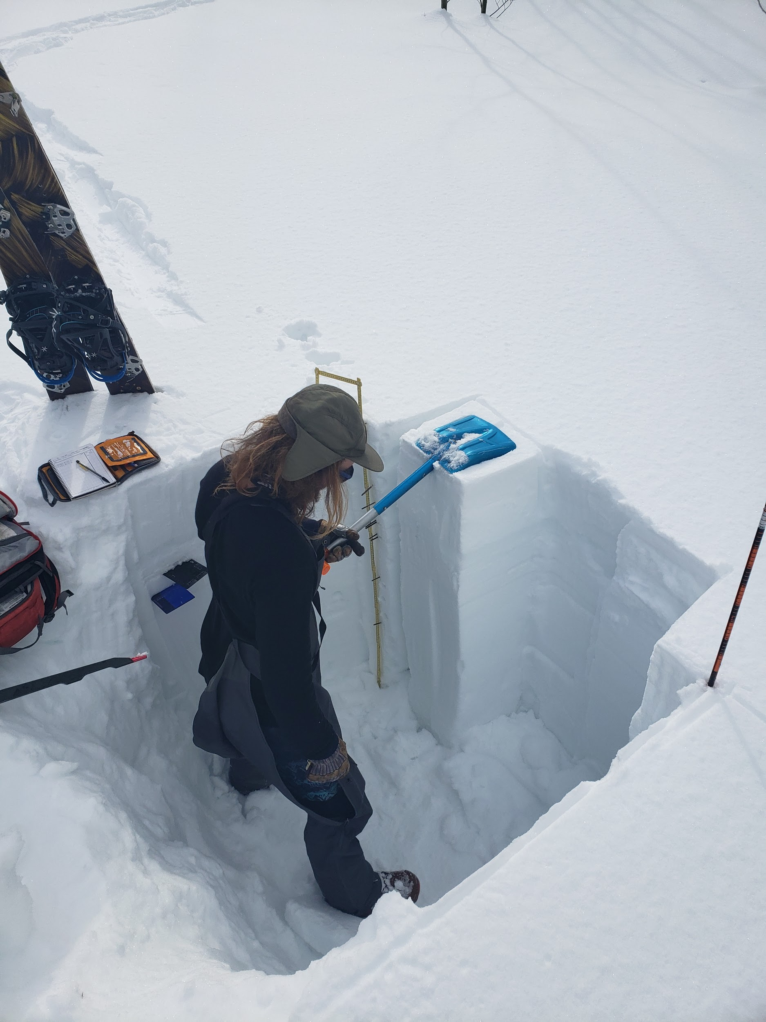
Test Pit 1: Bald Mountain Gore Range

Slide 6
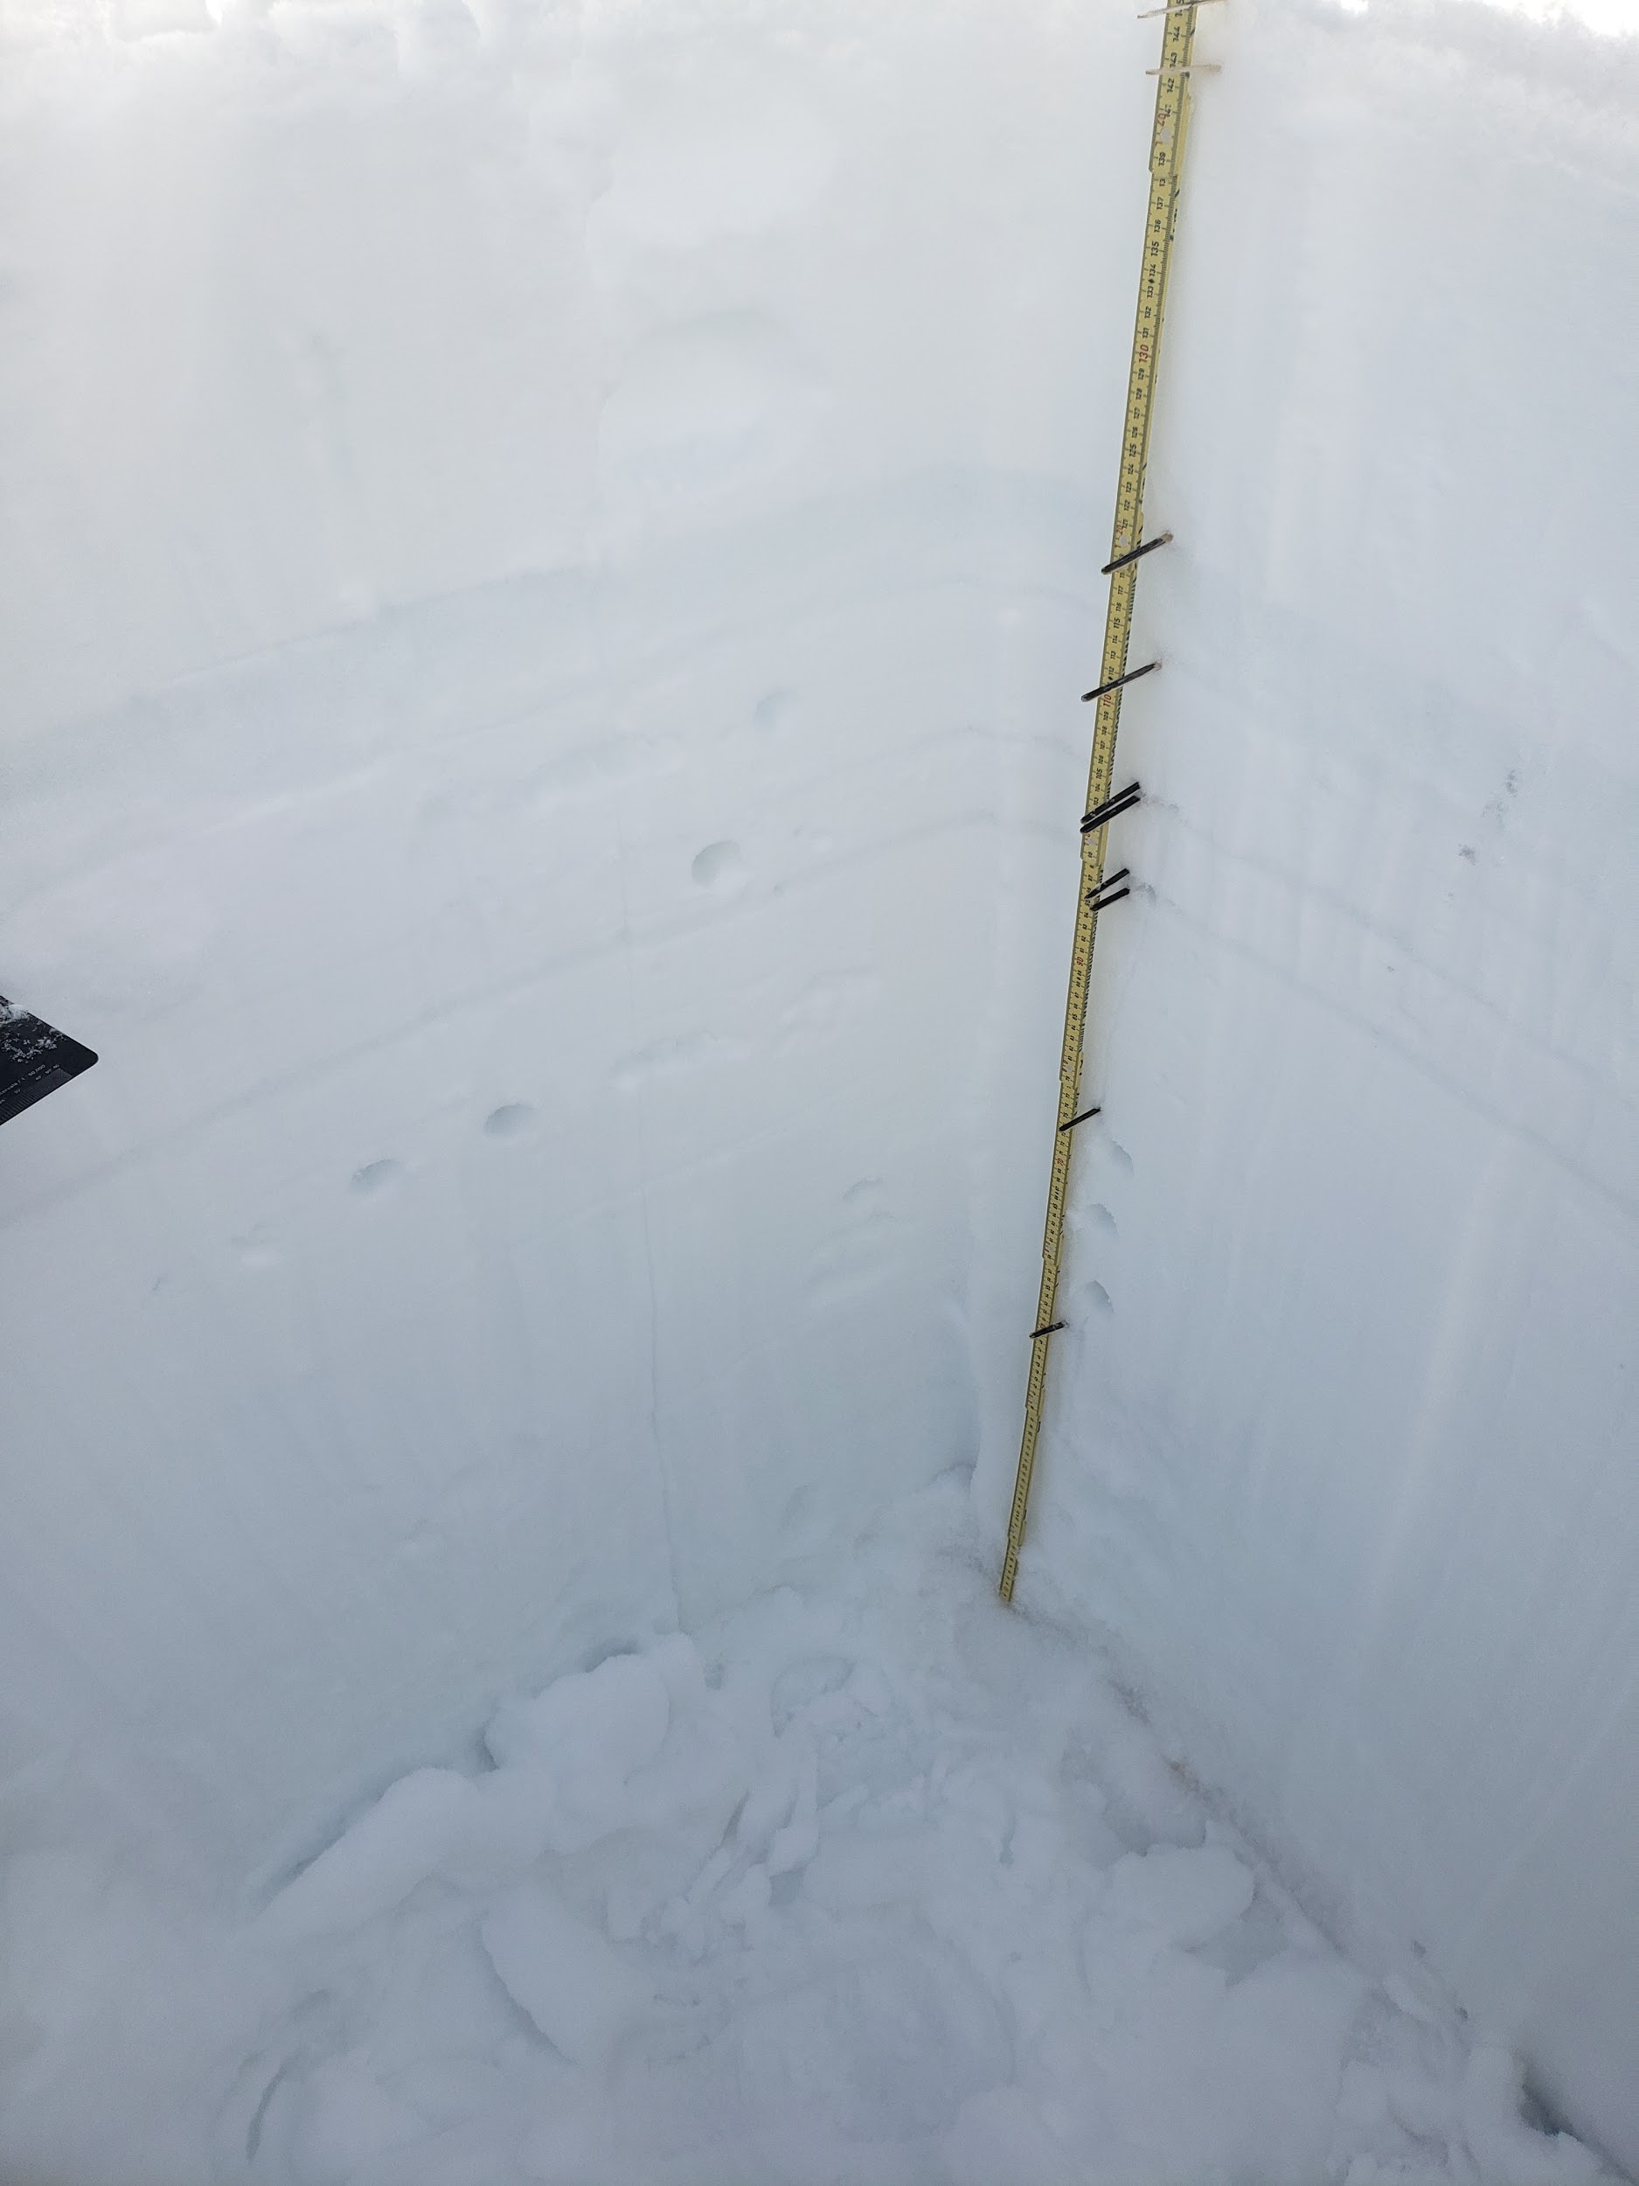
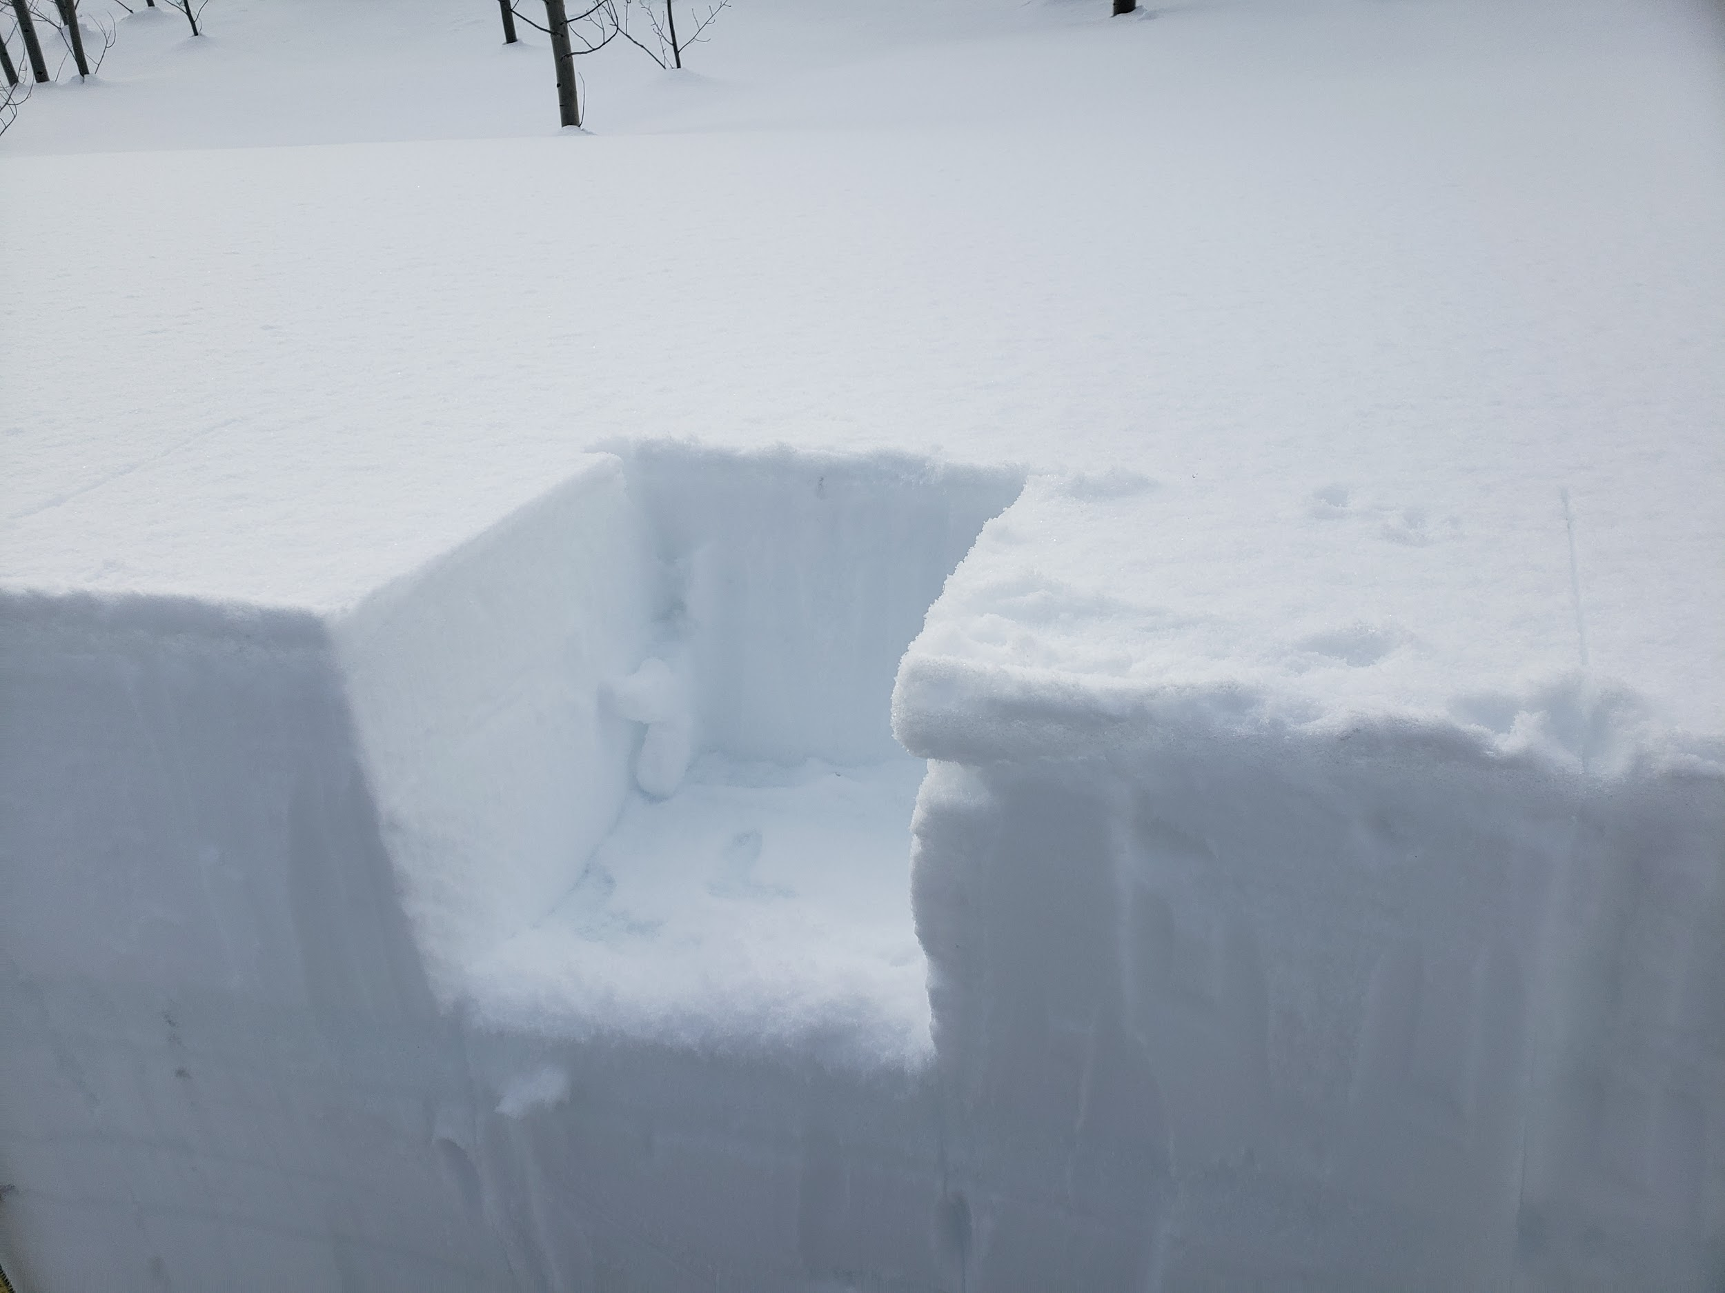

Slide 7
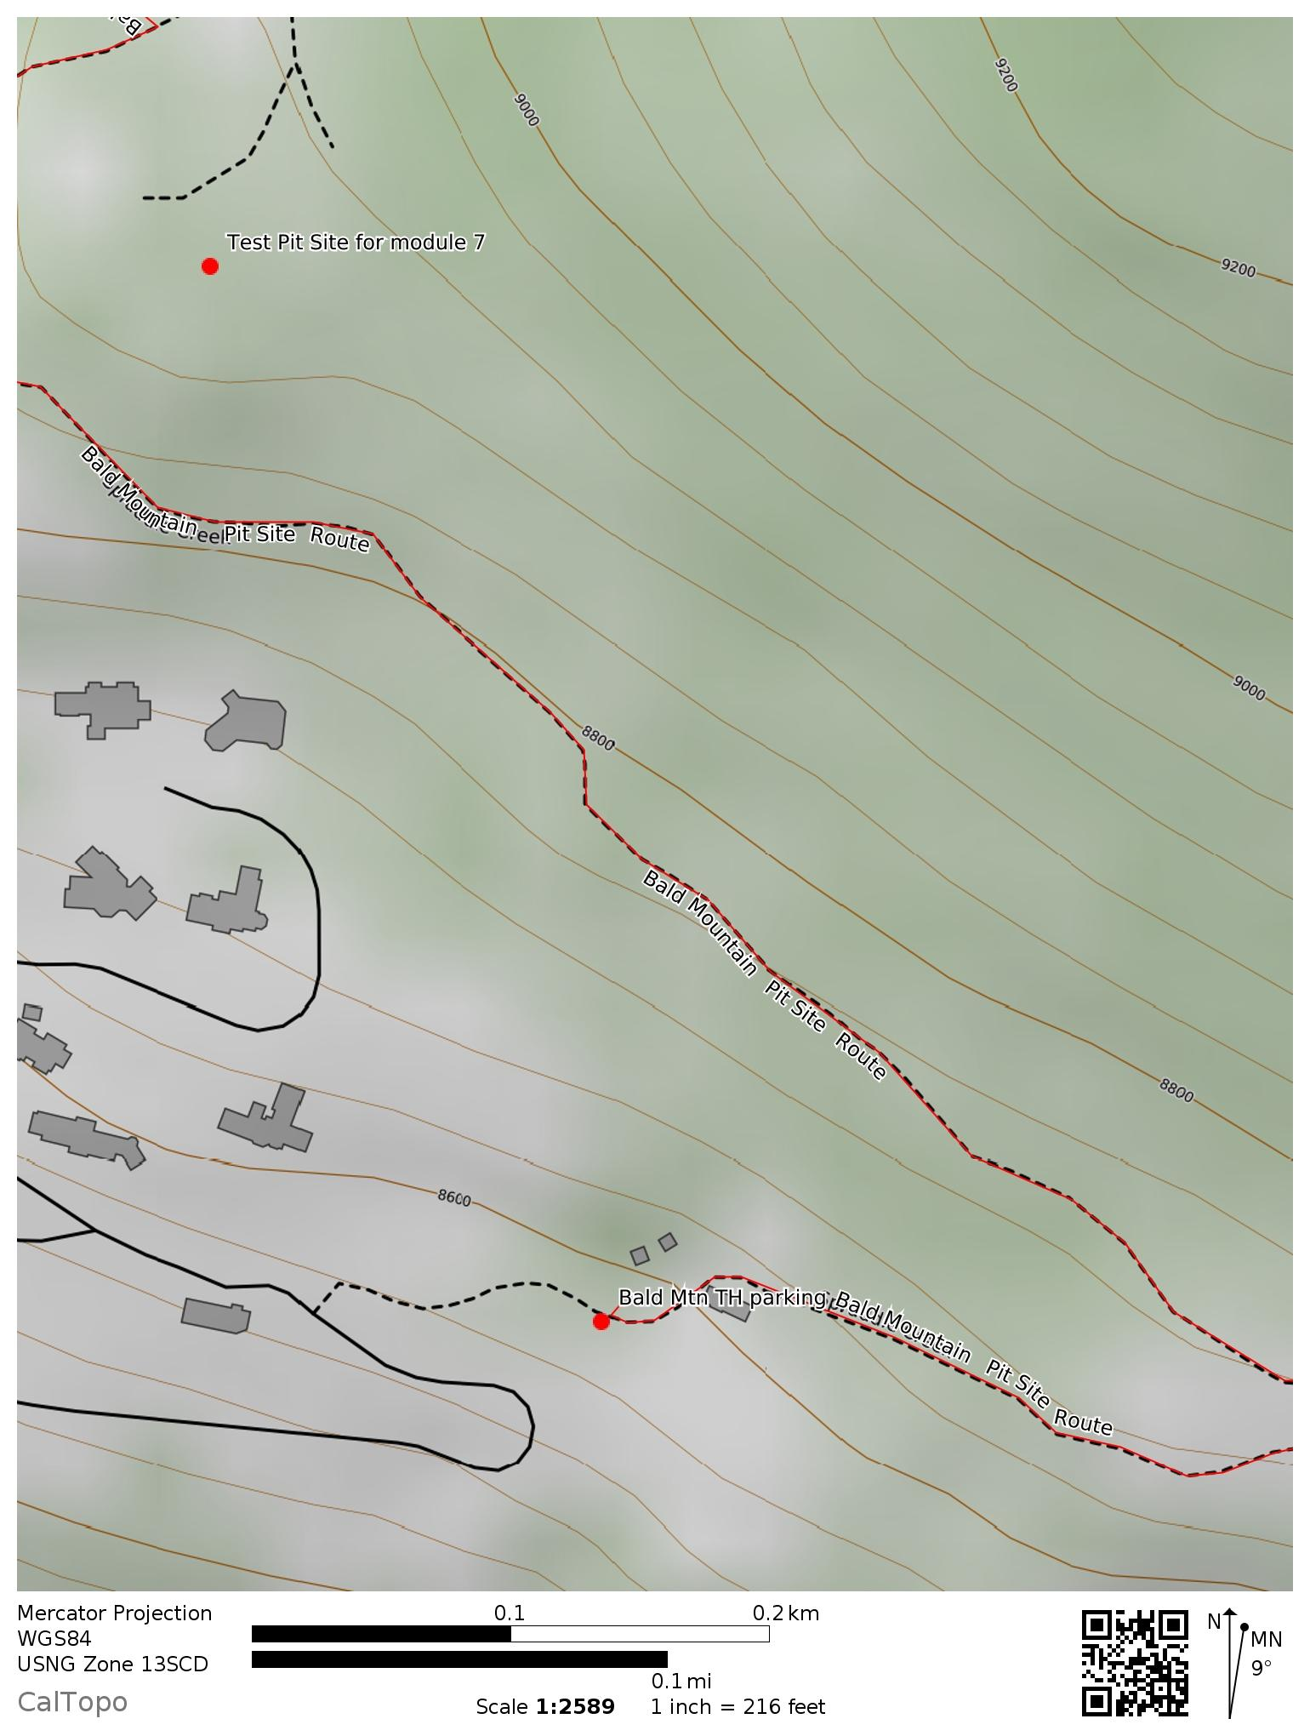
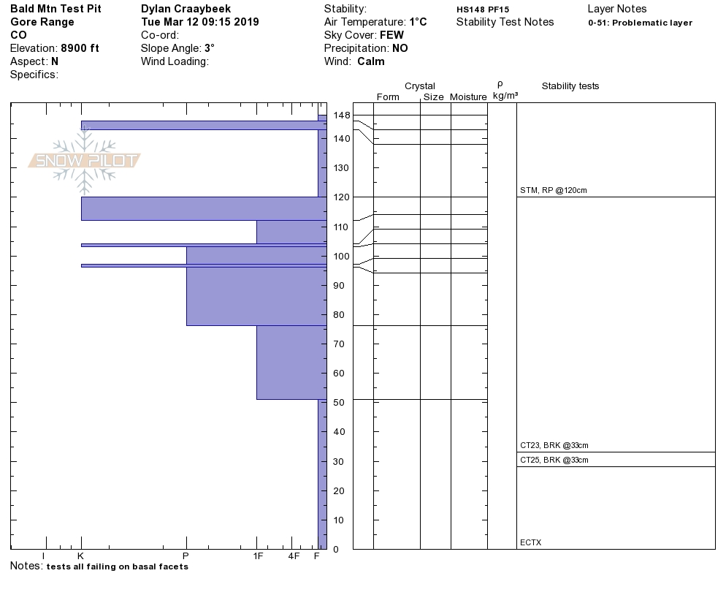

Slide 8
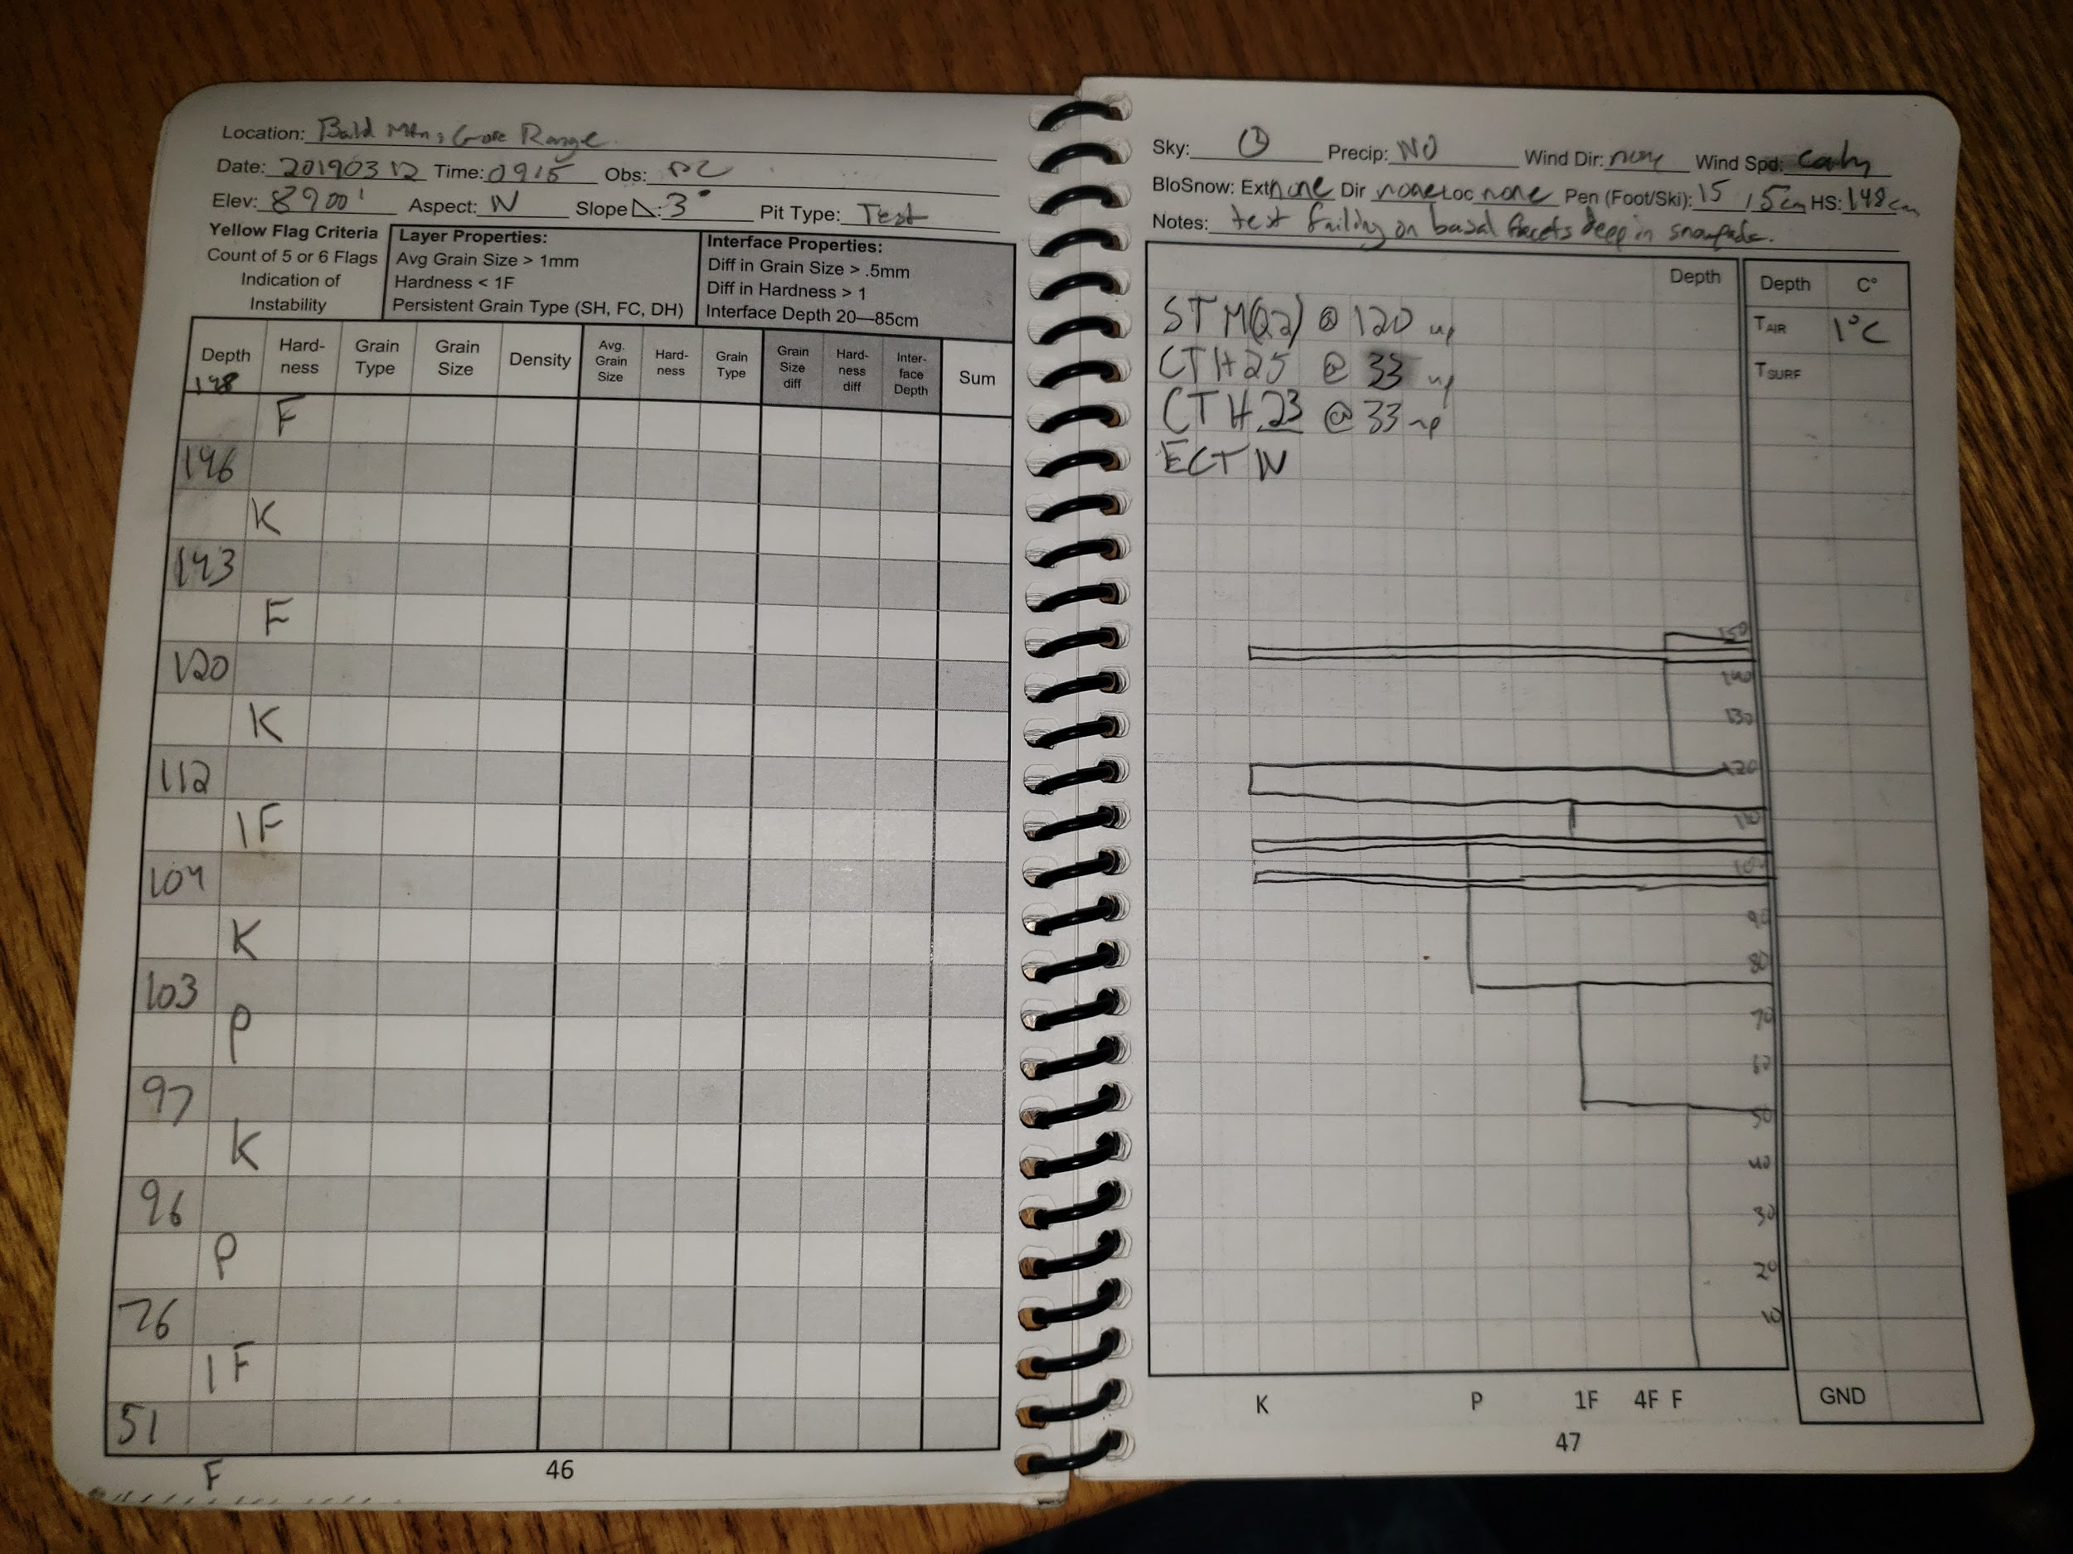

Slide 9
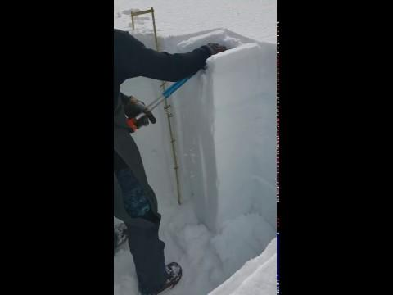

Slide 10
Test Pit 1 Summary
Many notable melt-freeze crusts that are indicative of a lower elevation test pit. Though it is a north facing aspect it is a very flat meadow that still receives a fair amount of sun most of the day. All my instability tests failed in the basal facets which makes sense considering the lack of a slab over or between any of the melt freeze crusts so the whole snowpack is virtually a slab over the weak faceted base of the snowpack.

Slide 11
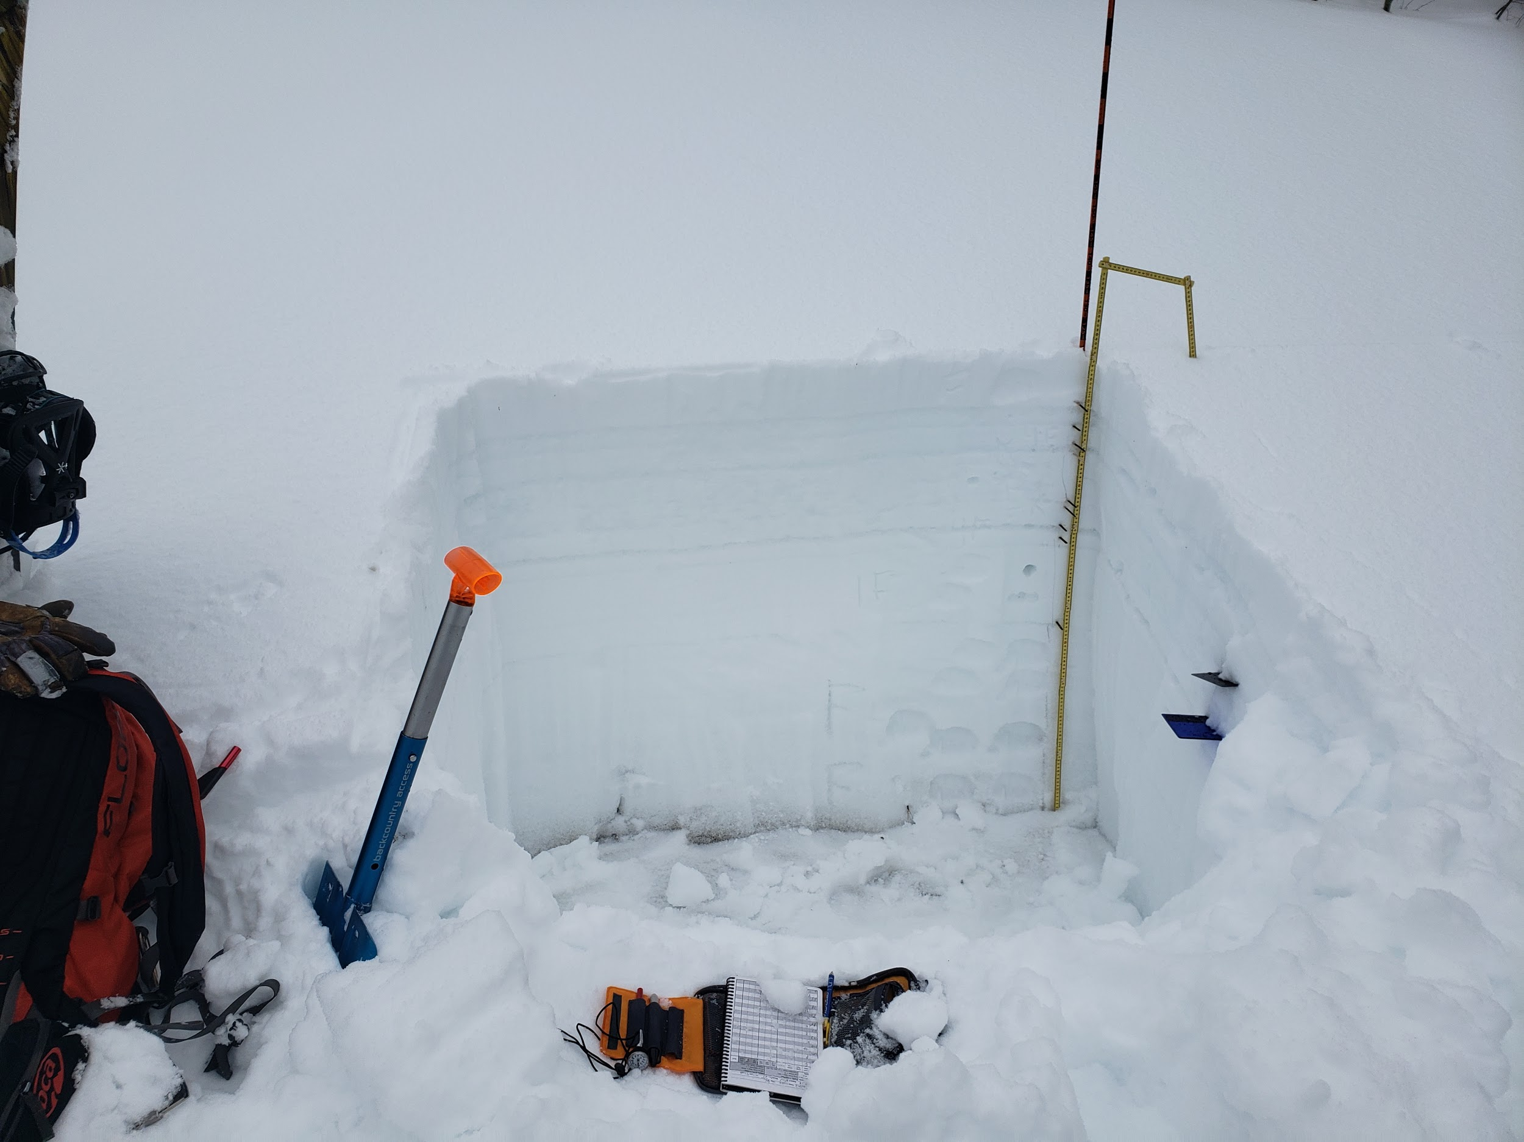
Test Pit 2: Grouse Mountain

Slide 12
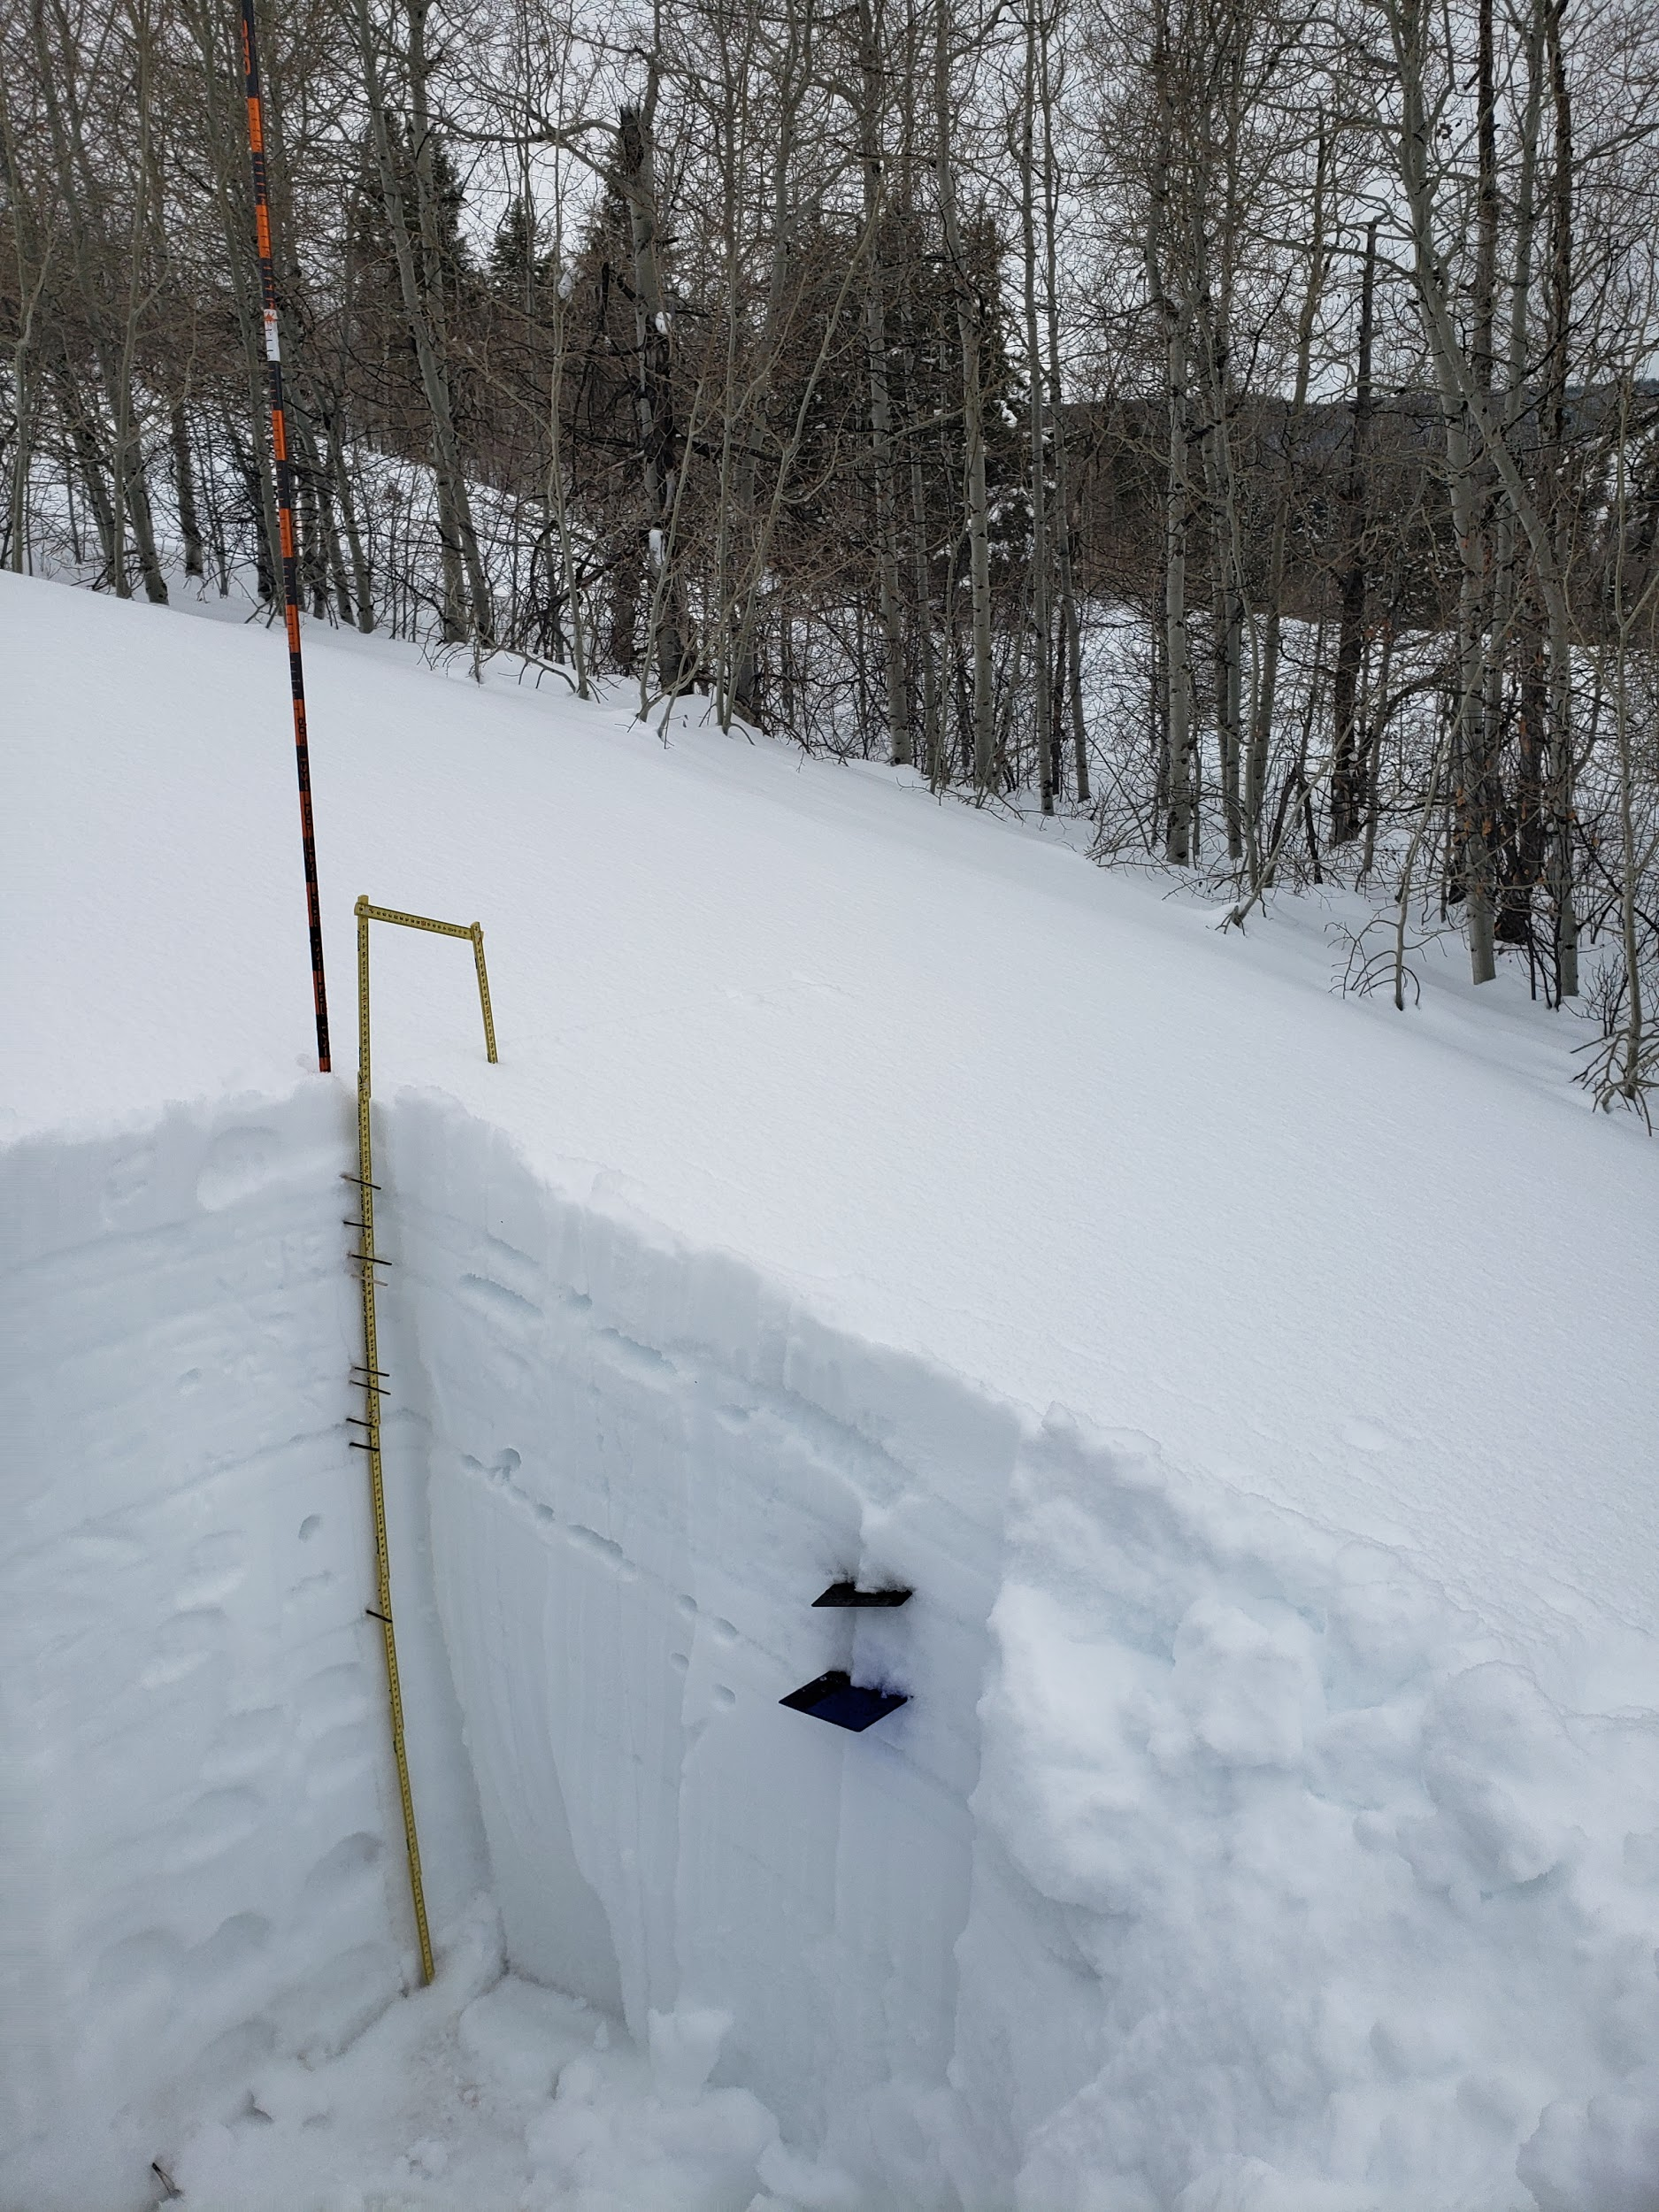
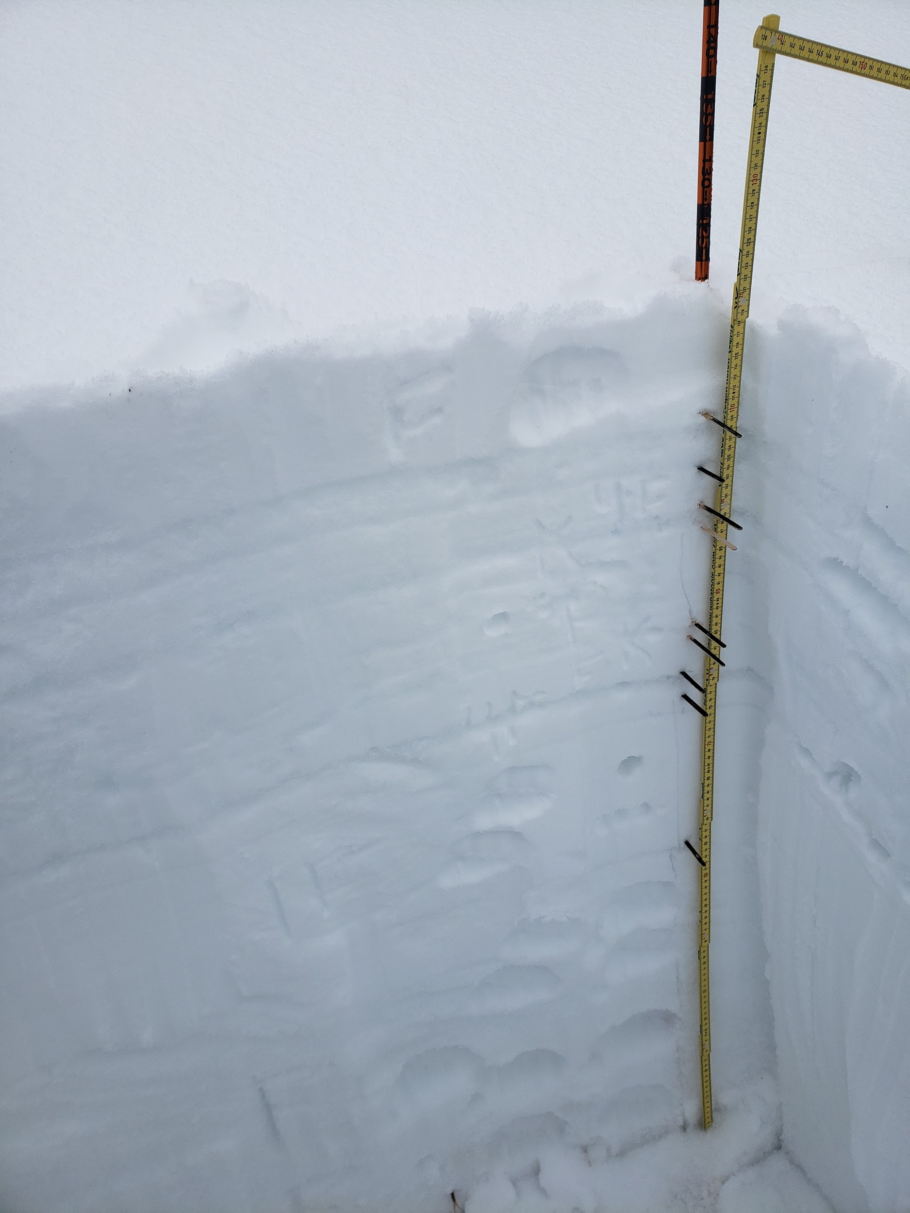

Slide 13
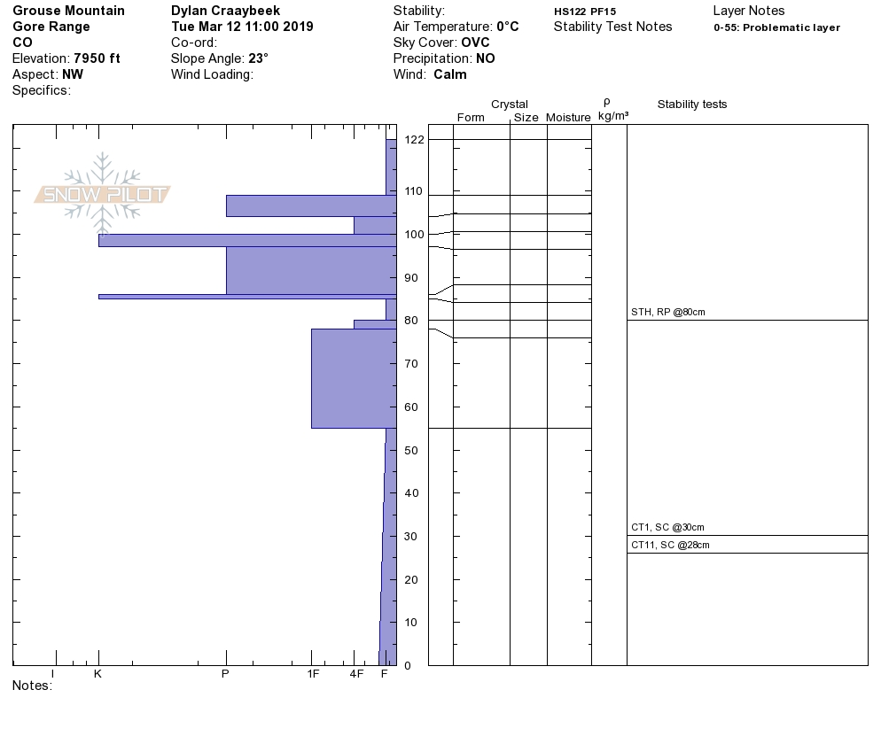

Slide 14
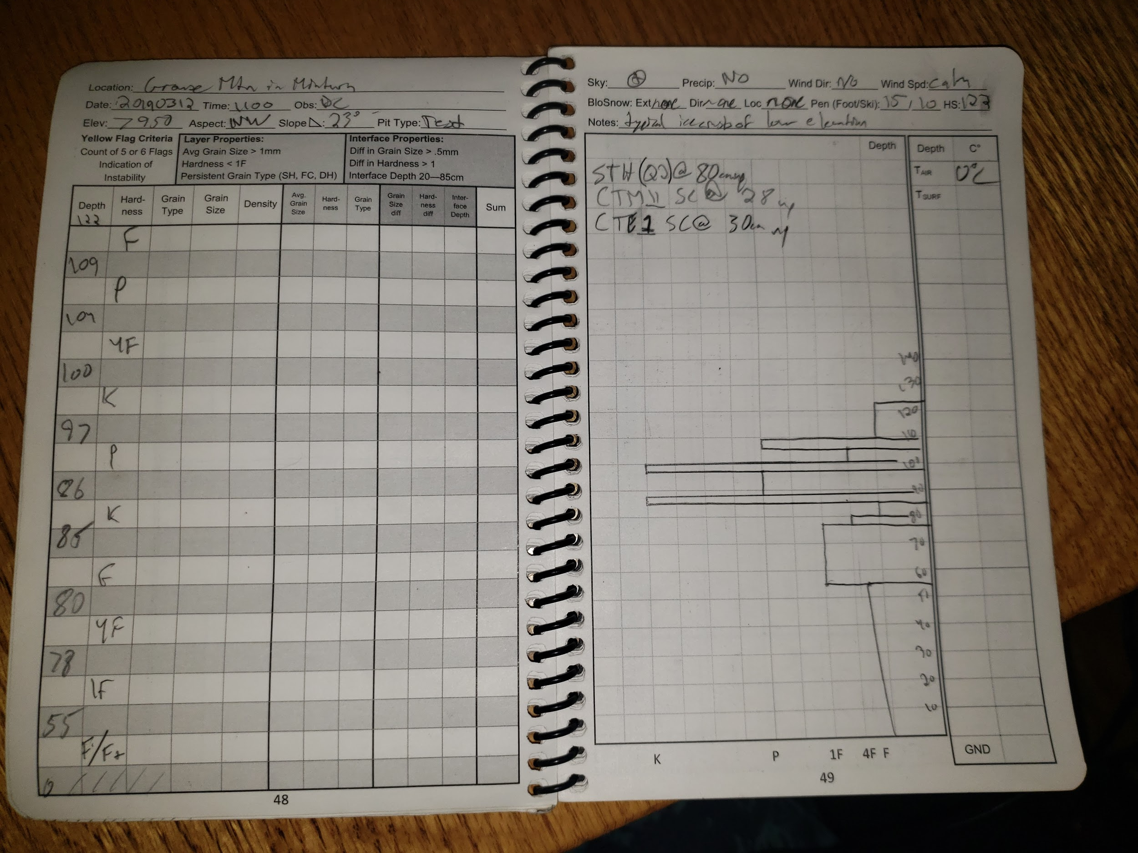

Slide 15
Test Pit 2 Summary
This pit also has some prominent melt freeze crusts indicative of a lower elevation snowpack. As with my test pit 1 all of my instability tests for this pit failed in the basal facets as I expected to happen.

Slide 16
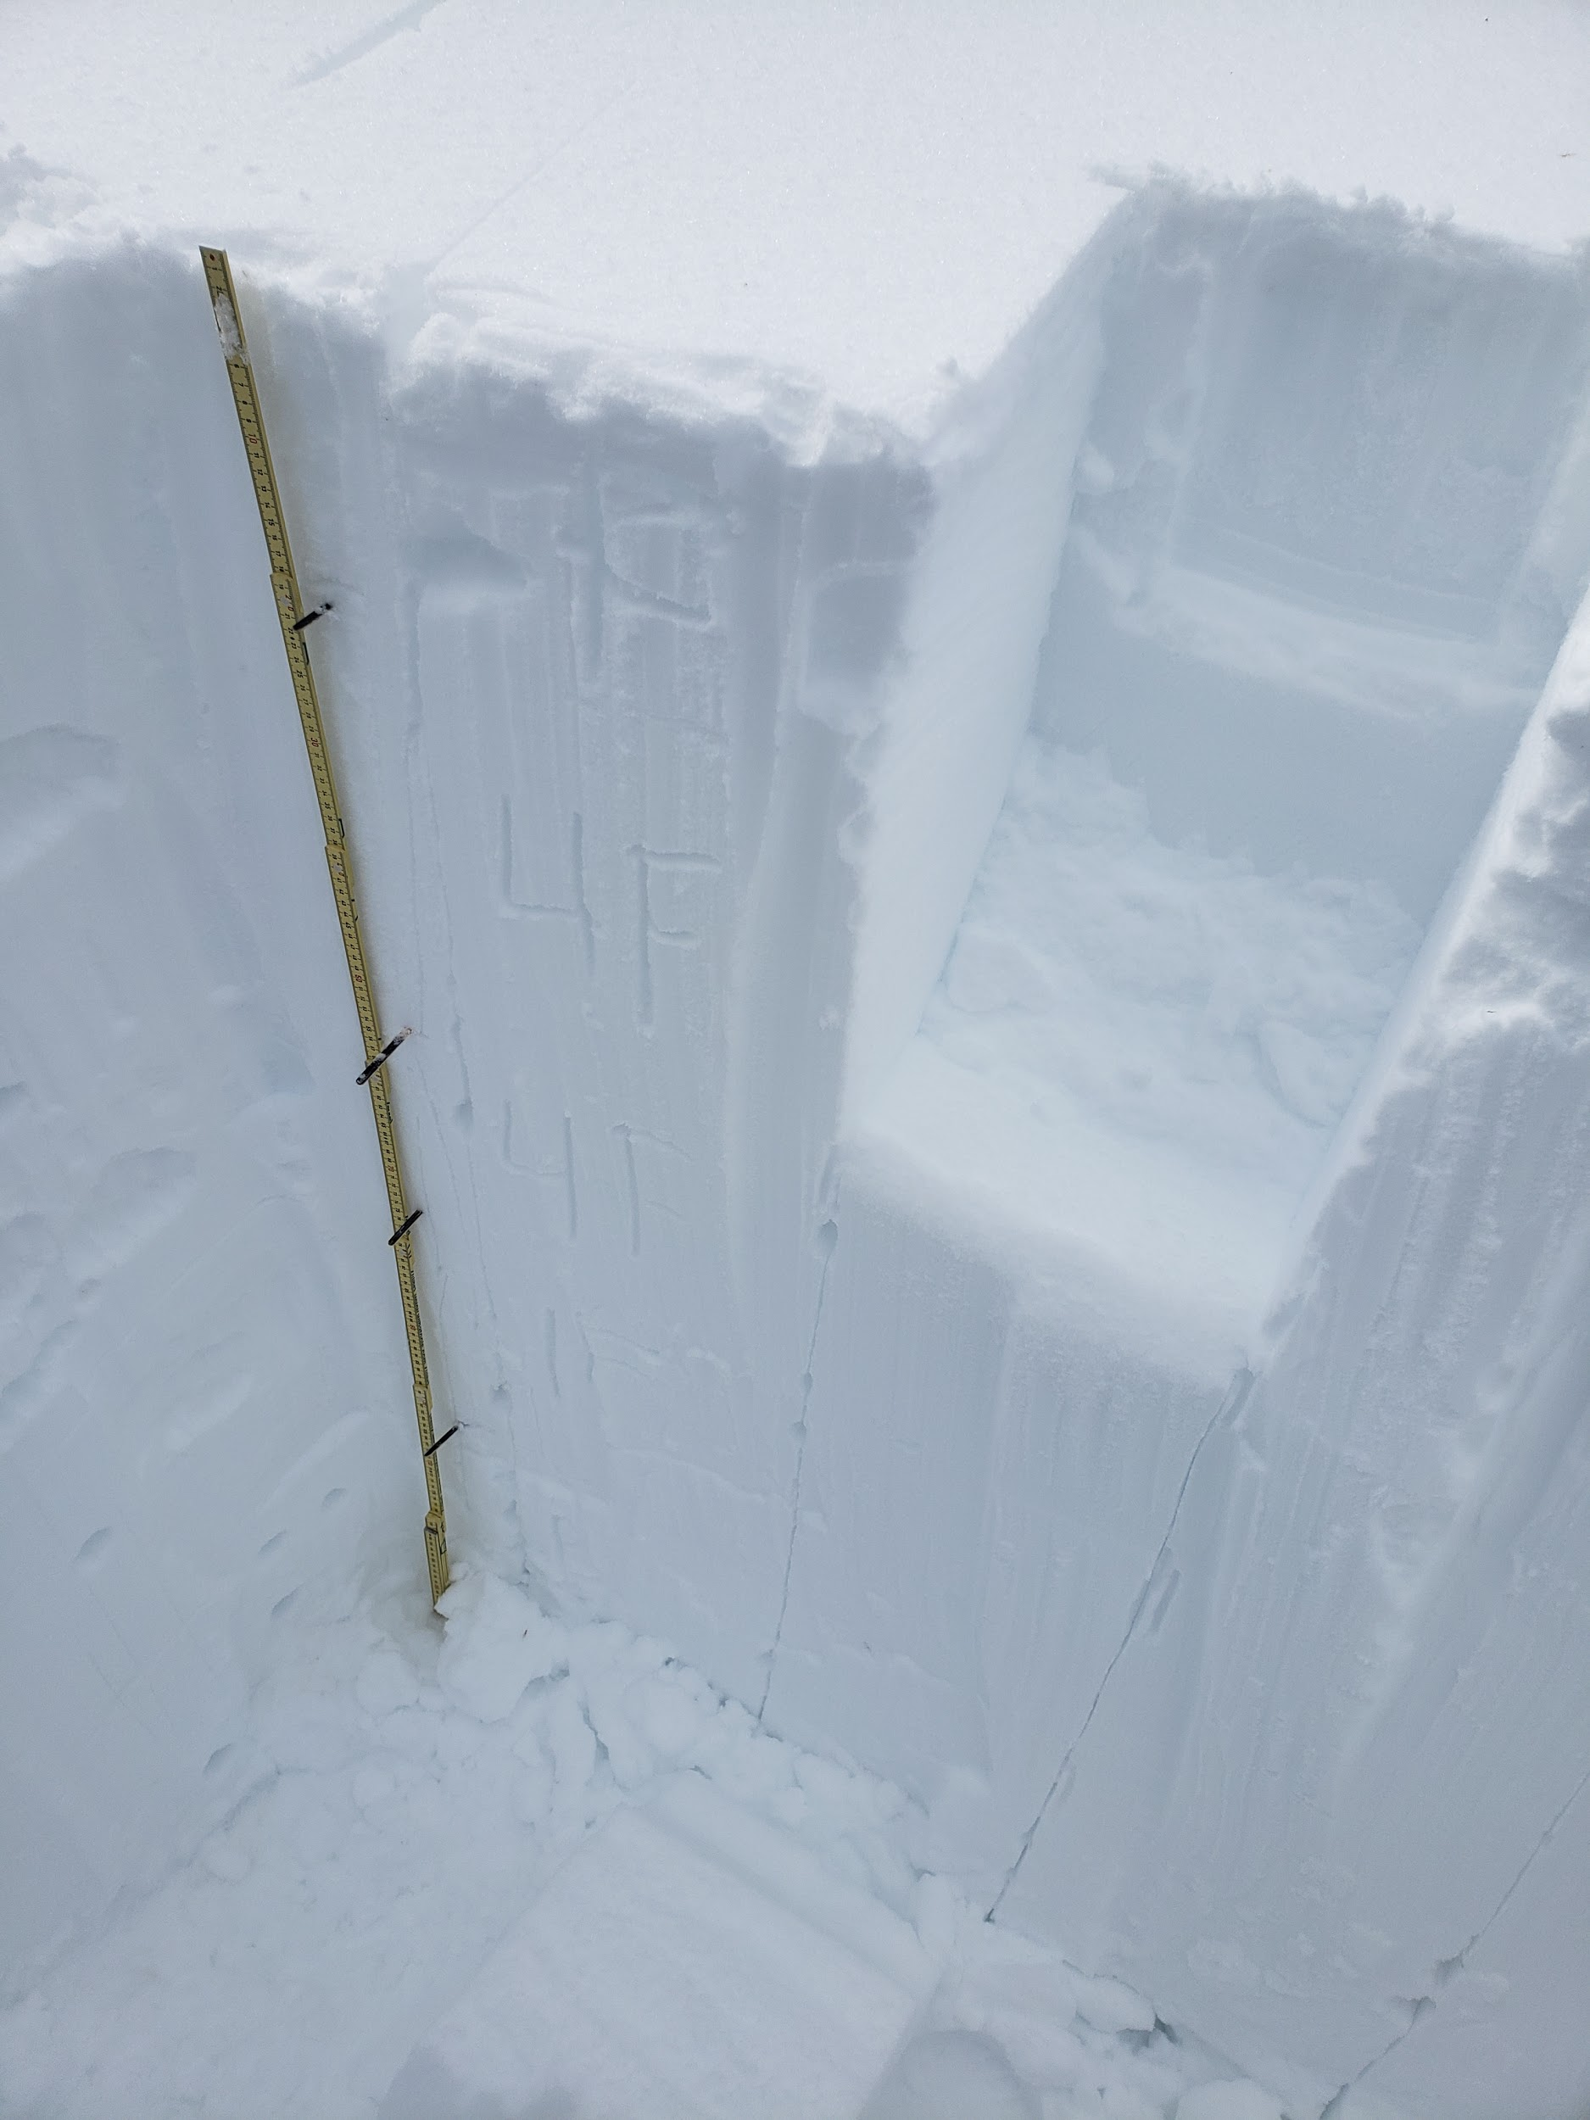
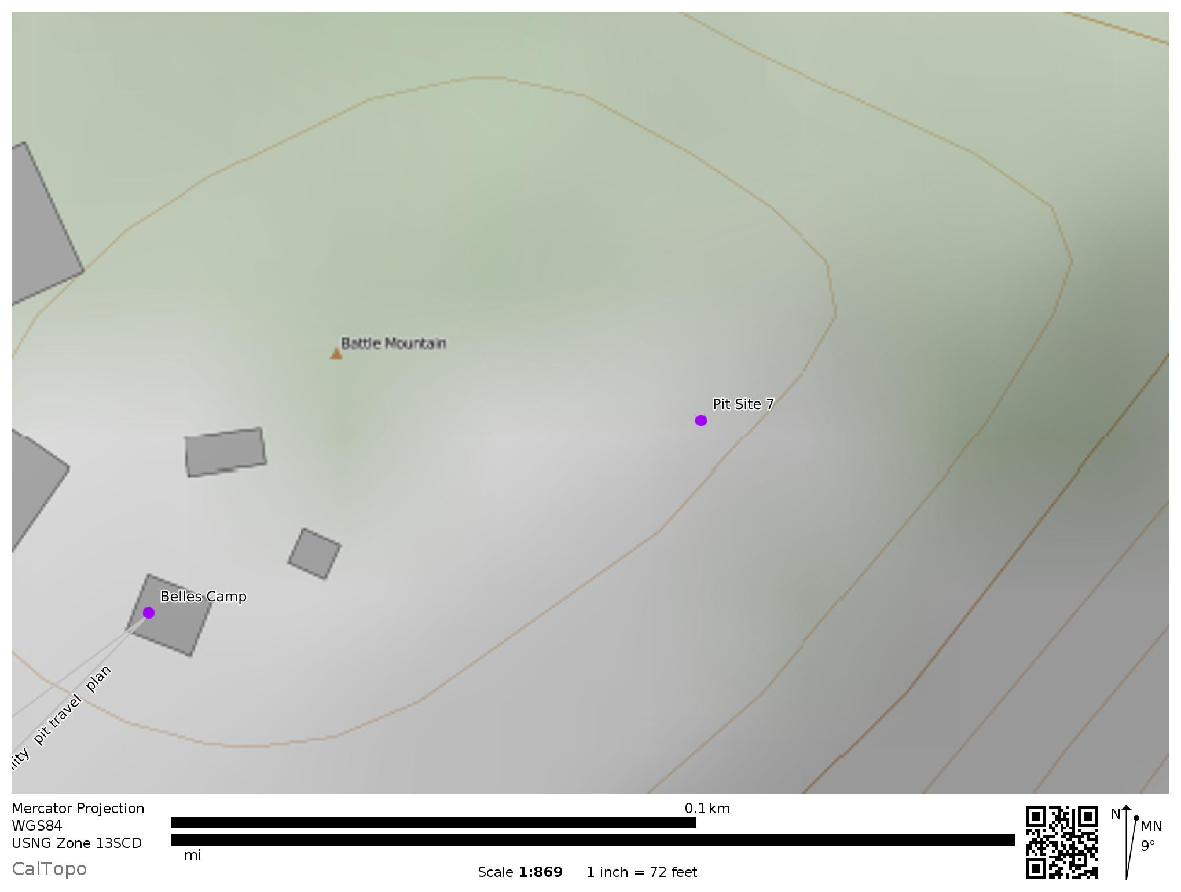
Test Pit 3: Belles Camp

Slide 17
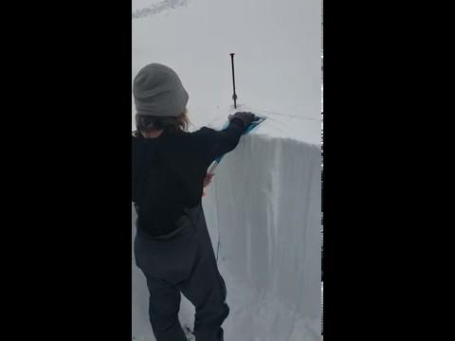

Slide 18
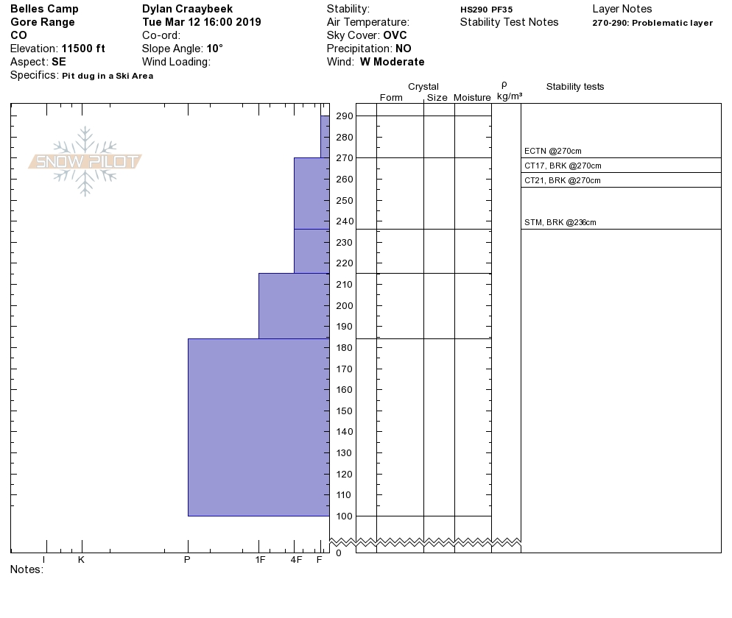

Slide 19
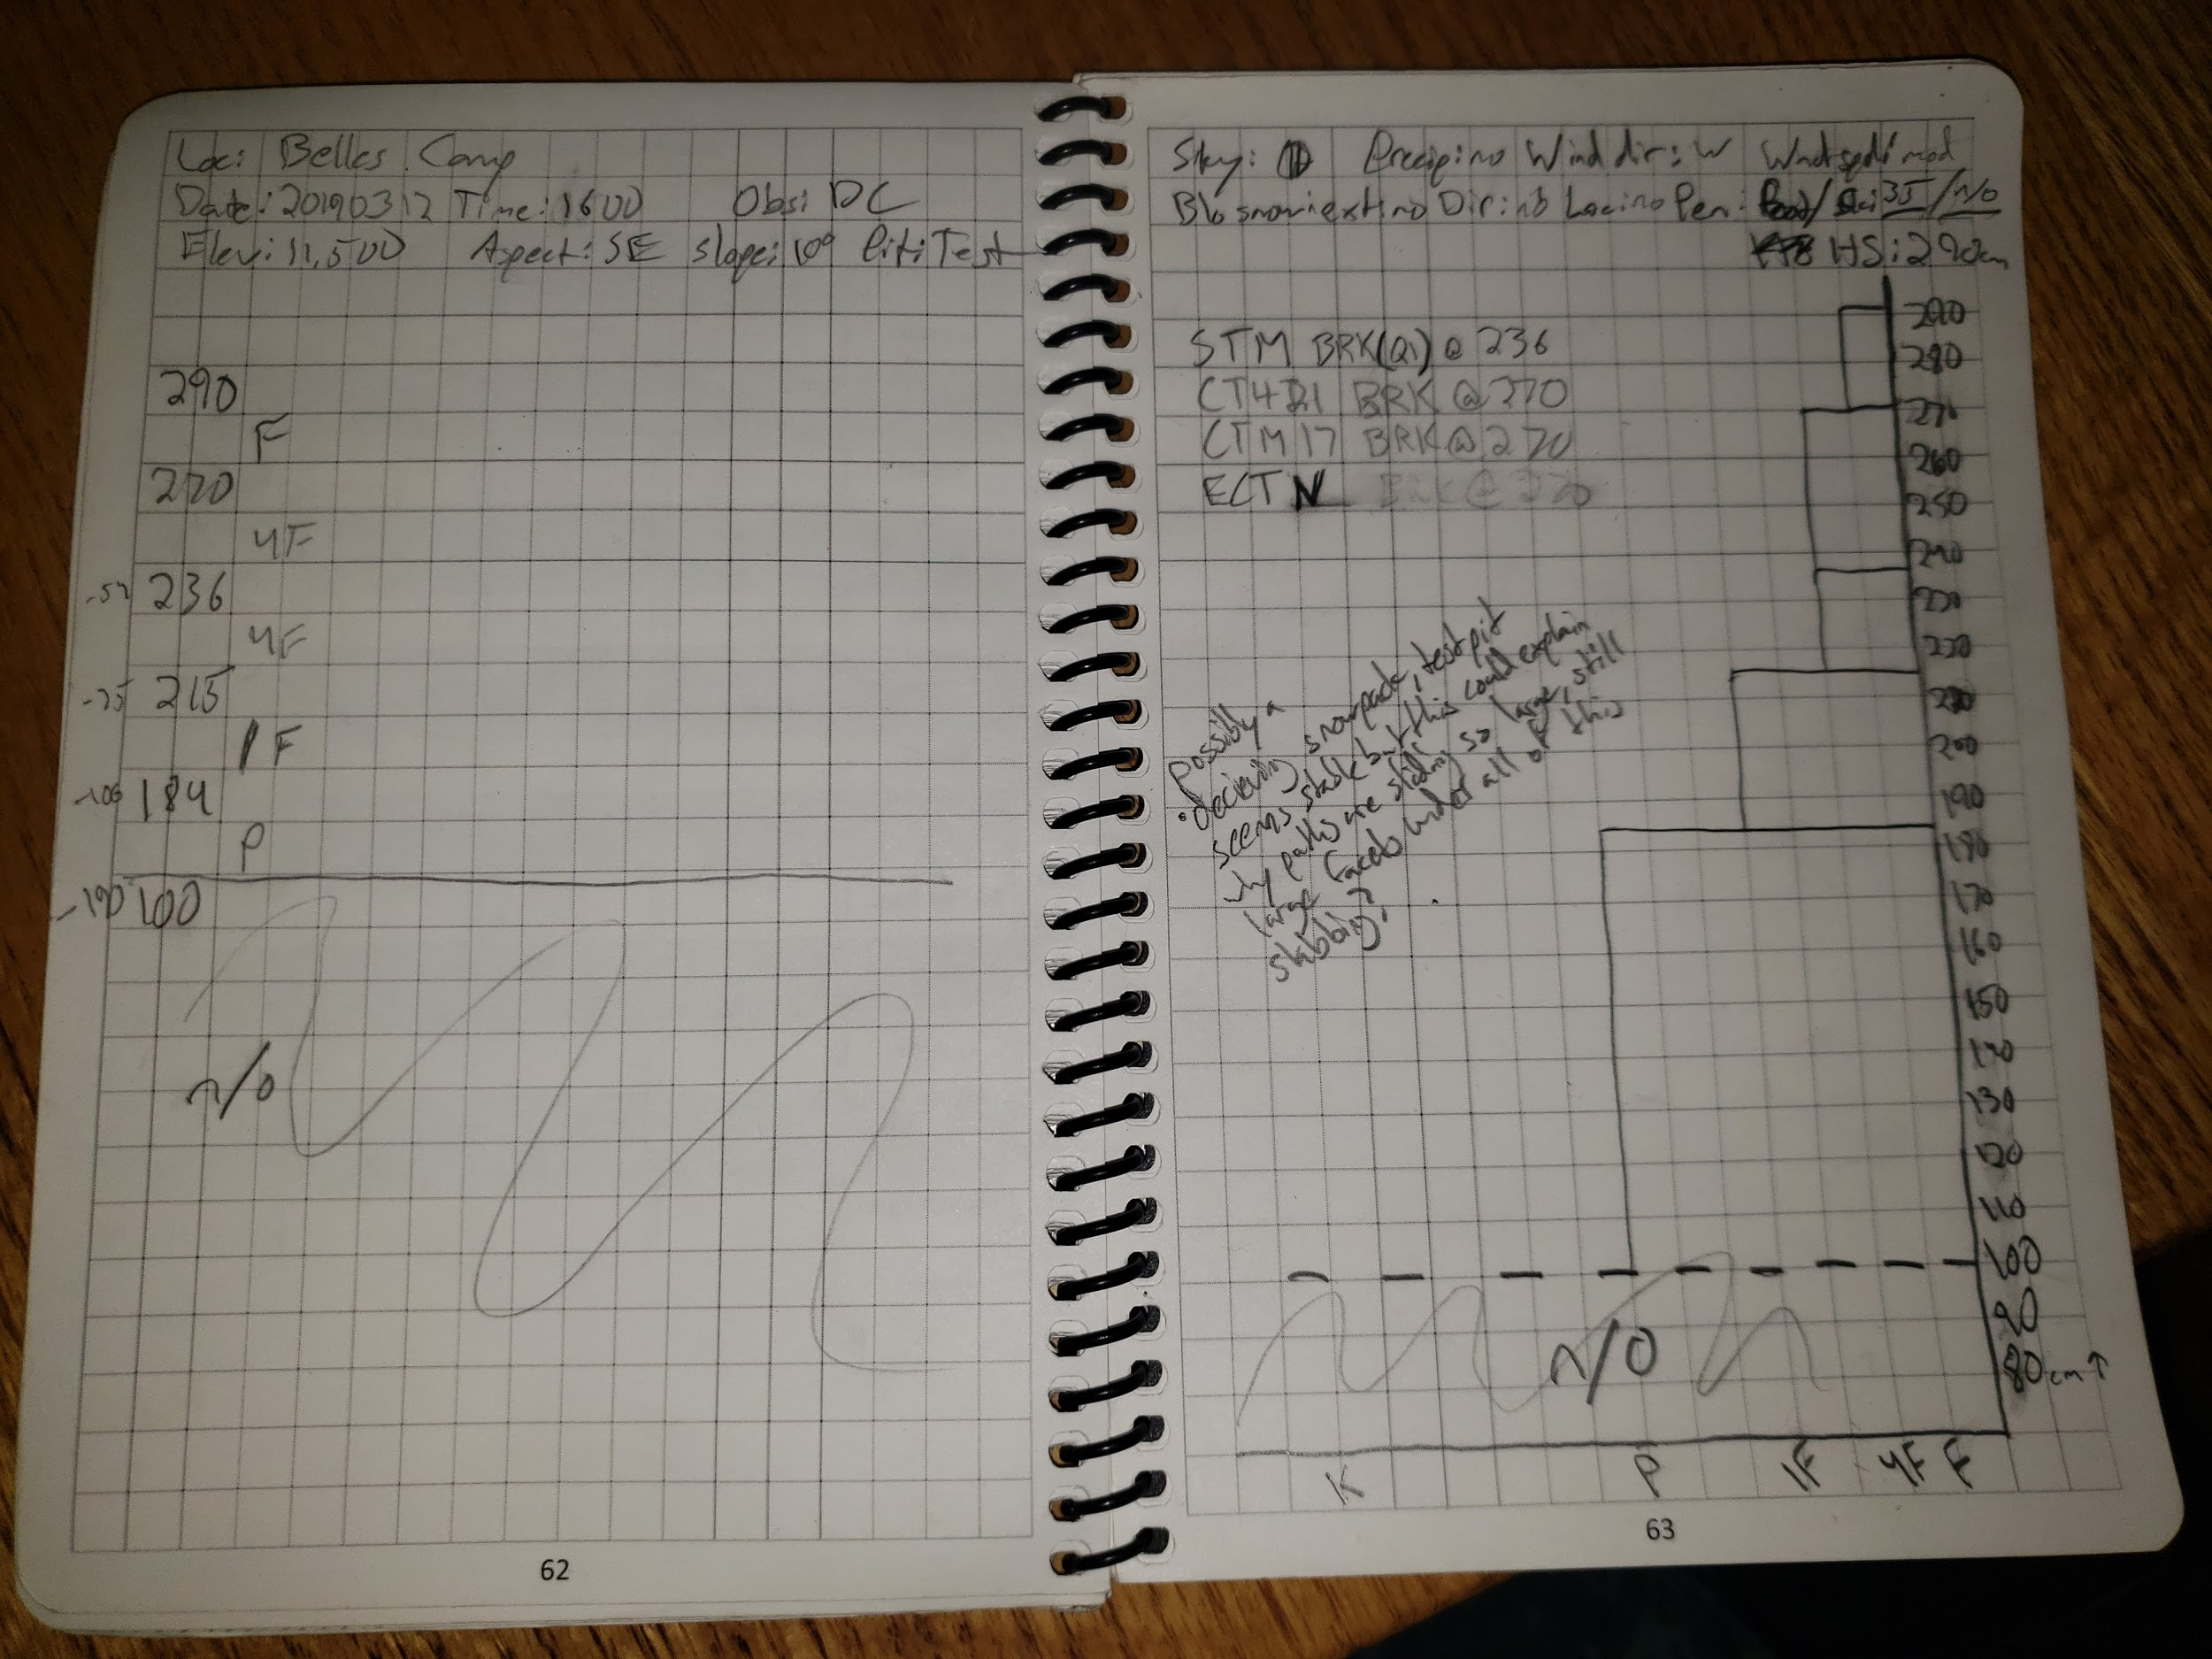

Slide 20
Test Pit 3 Summary
Test pits such as this one could potentially be dangerously deceptive to an inexperienced individual attempting to reassure themselves about the safety of a slope. Nothing about this test pit screams instability but I am aware of all of the very large and historic avalanches that have been happening so I dug a bit deeper to see if the deep layers were faceted and sure enough my foot found the basal facets before my shovel did and I fell into the facets up to my knee. What this pit tells me is there is a potentially very large slab sitting on a weak layer on top of ground but I can see how an average recreationalist may just dig 150 or so cm deep get reassuring results on their instability tests and decide it is a safe slope then find the trigger point and the whole snowpack slides out from under them.

Slide 21
Summary
Although I did not quite have the time to safely dig the test pits 10km apart I am confident they are far enough apart to analyze spatial variability throughout a potential forecast zone. Test pits 1 and 2 were very similar to what I would expect of a lower elevation snowpack in meadows that get a decent amount of short wave radiation from the sun even though they are both on northerly aspects.. They both had several melt-freeze crusts that were indicative of a lower elevation snowpack and most instability tests for both of these pits were failing on basal facets from November, December, and possibly some early January snow. Test pit 1, though higher in elevation, had more melt-freeze crusts than test pit 2. I suspect this is from the slope angle and proximity to trees capable of emitting longwave radiation. Pit 1 was in a meadow surrounded by trees and a much less steep slope angle so absorbs more short wave radiation from the sun throughout the day time. Pit 2 was near trees to the west but no trees were close enough to affect it from any other directions and it was a more Northerly facing slope with a steep slope angle so less short wave absorption from the sun.

Slide 22
Summary cont.
Test pit 3 was very different as I expected it to be, being a much higher elevation and opposite aspect than pits 1 and 2. I likely only dug deep enough to observe the late January, February, and March snow. From 290cm to 100cm the snow has settled and hardened forming a large cohesive slab on top of 30-50cm of basal facets that a discovered with my foot after falling through the bottom of my test pit. This tells me what the CAIC has been telling me about the avalanche problem on the advisory, hard to trigger deep persistent slab that will run large to historic if triggered. Since the first Feb. Storm cycle this area has been consistently getting loaded with snow so the layers haven’t had time to facet thus making this very large cohesive slab including all the snow from March Feb and possibly late Jan.

